Slide 1

Kubernetes Failure Prediction: An AI/ML Model
This presentation explores the development of an AI/ML model for predicting failures in Kubernetes clusters. Proactive prediction is crucial for maintaining high availability and optimizing resource usage. We will cover the methodology, data preprocessing, feature engineering, model selection, and evaluation of this model.

Slide 2
Problem Statement: The Challenge
Operational Issues
Impact
Pod crashes
Downtime and service disruptions
Resource bottlenecks
Degraded application performance
Network issues
Increased operational costs
Kubernetes clusters face issues that lead to downtime, performance degradation, and increased costs. The objective is to build a model that predicts these failures and improves reliability by enabling early intervention.

Slide 3
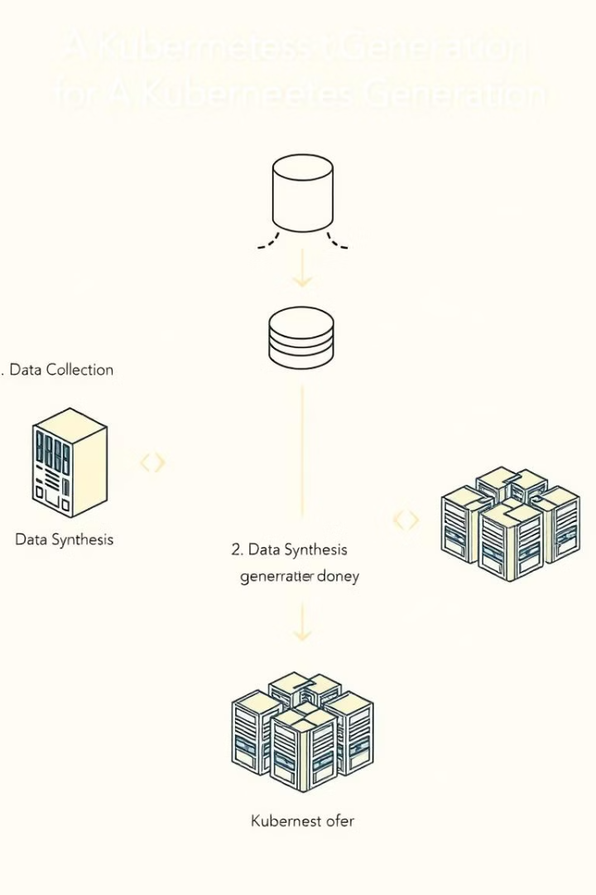
Methodology: Data Collection
Synthetic Dataset
Metrics
A synthetic dataset simulating Kubernetes cluster behavior was generated using Python.
CPU usage
Memory usage
Network I/O
Failure Types
Node Failure (5%)
Resource Exhaustion (5%)
Network Issue (3%)
Service Disruption (2%)
The dataset includes various metrics collected at 1-minute intervals, with realistic ranges for normal and failure scenarios. The dataset contains 100,000 records.

Slide 4
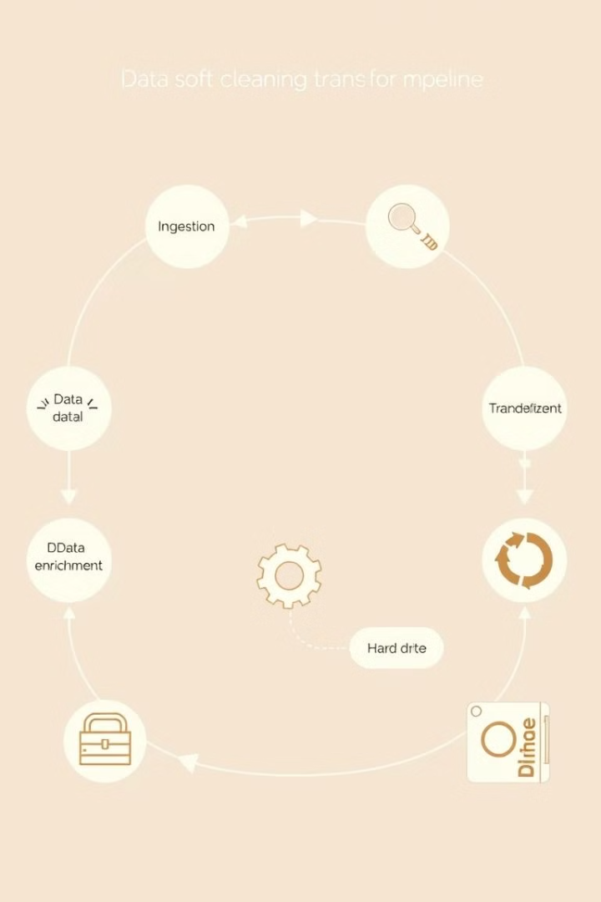




Data Preprocessing: Preparing the Data
Missing Values
Mean imputation was used for numerical features.
Categorical Encoding
One-hot encoding was applied to categorical variables.
Feature Scaling
StandardScaler was used to normalize the numerical data.
Class Imbalance
SMOTE was applied to balance the class distribution.

Slide 5








Feature Engineering: Enhancing Accuracy
Time-Based Features
Anomaly Score
Extracted hour of the day and day of the week.
Calculated the deviation of CPU and memory usage from rolling averages.
Interaction Terms
Rolling Averages
Combined CPU, memory, and network metrics.
Computed rolling averages for CPU, memory, and disk usage.
Advanced feature engineering was performed to enhance the model’s predictive accuracy. Anomaly scores, rolling averages, and interaction terms were created.

Slide 6
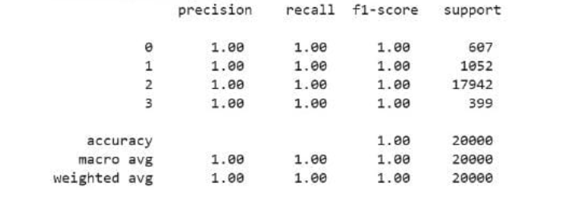
Model Selection: Choosing the Best Algorithm
Random Forest
XGBoost
Ensemble learning method known for robustness.
Gradient boosting algorithm with high accuracy.
Logistic Regression
Simple baseline model for comparison.
Random Forest was selected due to its superior performance metrics, robustness against missing values, and ability to handle large datasets effectively.

Slide 7

Model Training: Fine-Tuning the Model
Hyperparameter Tuning
Cross-Validation
5-fold cross-validation was used to evaluate model generalization.
n_estimators: 200
max_depth: 30
Training Process
80% for training, 20% for validation.
The Random Forest model was fine-tuned using RandomizedSearchCV. The dataset was divided into 80% for training and 20% for validation.

Slide 8
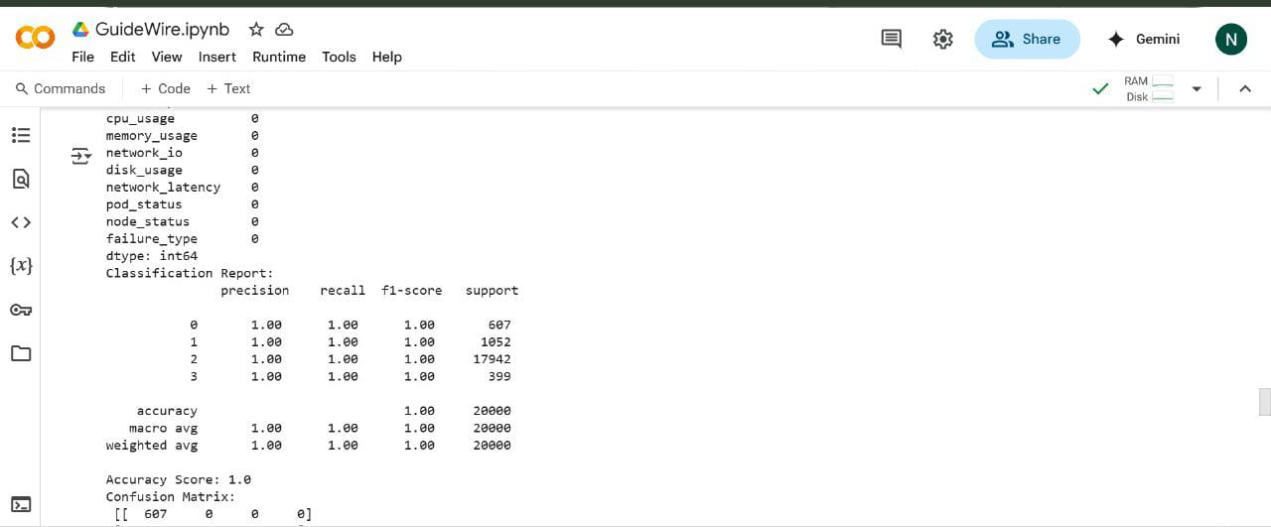
Model Evaluation: Performance Metrics
100%
Accuracy
Perfect accuracy in predicting failure scenarios.
The model demonstrated perfect accuracy, effectively predicting all failure scenarios without any misclassifications.

Slide 9
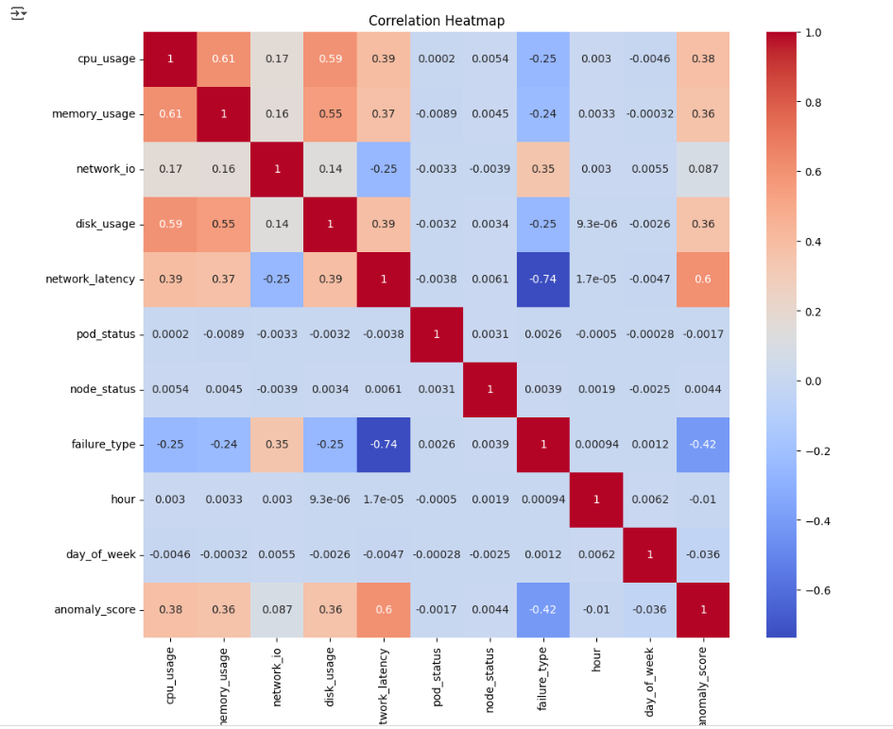

Slide 10
Results and Visualization
Correlation Heatmap
Feature Importance Plots
Displayed the correlation between metrics. Identified strong relationships between CPU usage, memory usage, and network latency.
Highlighted the most significant predictors: CPU usage, memory usage, and network latency.
Correlation heatmaps and feature importance plots help visualize the model's findings and identify key factors contributing to failures.

Slide 11

Limitations and Future Improvements
Integration
Anomaly Detection
Incorporate the model with Prometheus and Grafana for real-time monitoring.
Real-time Prediction
Add anomaly detection algorithms for better failure detection.
Deploy the model with real-time Kubernetes metrics.
Future improvements include real-time prediction, anomaly detection, and integration with monitoring tools. Bayesian optimization can further fine-tune hyperparameters.

